Slide 1
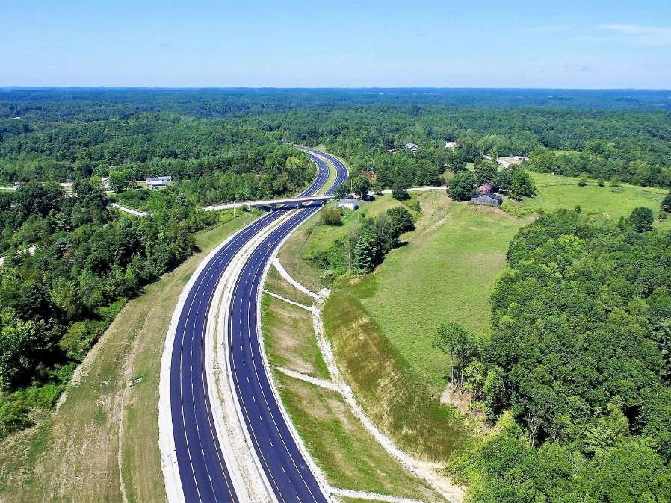
Bert t. combs Mountain parkway reconstruction
Bert t. combs
Mountain parkway
wolfe county
district 10 design section

Slide 2
PROJECT TYPICAL SECTION
DESIGN CRITERIA | EXISTING | FINAL
# OF LANE | 2 | 2
PAVE WIDTH | 12 LANE’ | 12 LANE’
OUT. SHLD WIDTH | 10’ | 10’
IN. SHLD WIDTH | 4’ | 4’
MIN. RADIUS | 955’ | 1310’
MAX. GRADE | 1.6% | 1.6%

Slide 3
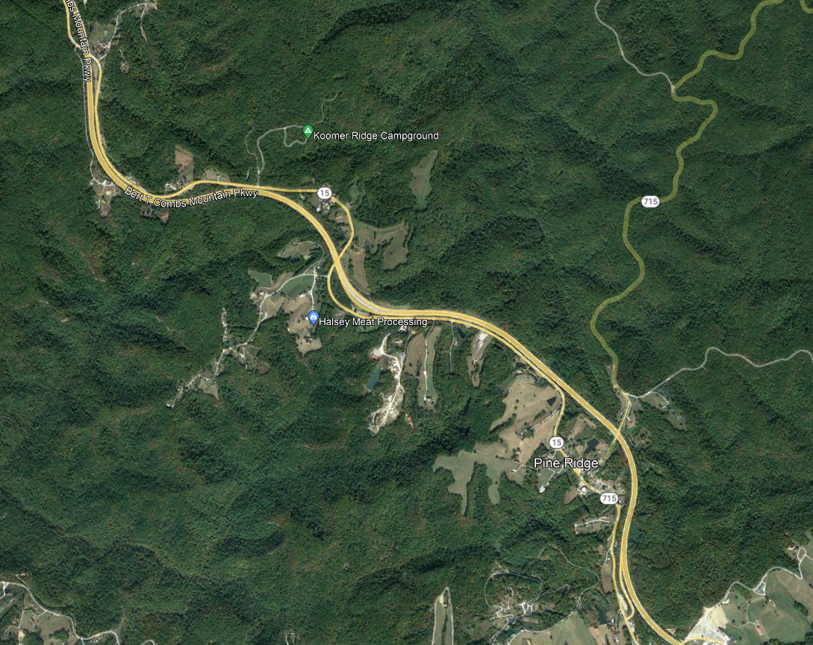
Mountain Parkway, Winchester to Campton Corridor
TO STANTON
10-162.00
TO CAMPTON

Slide 4
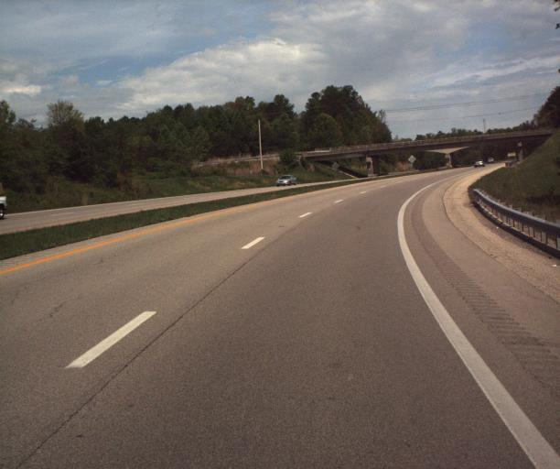
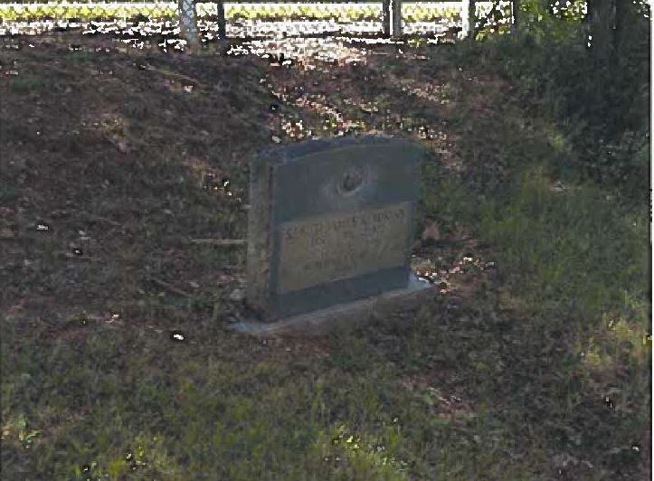
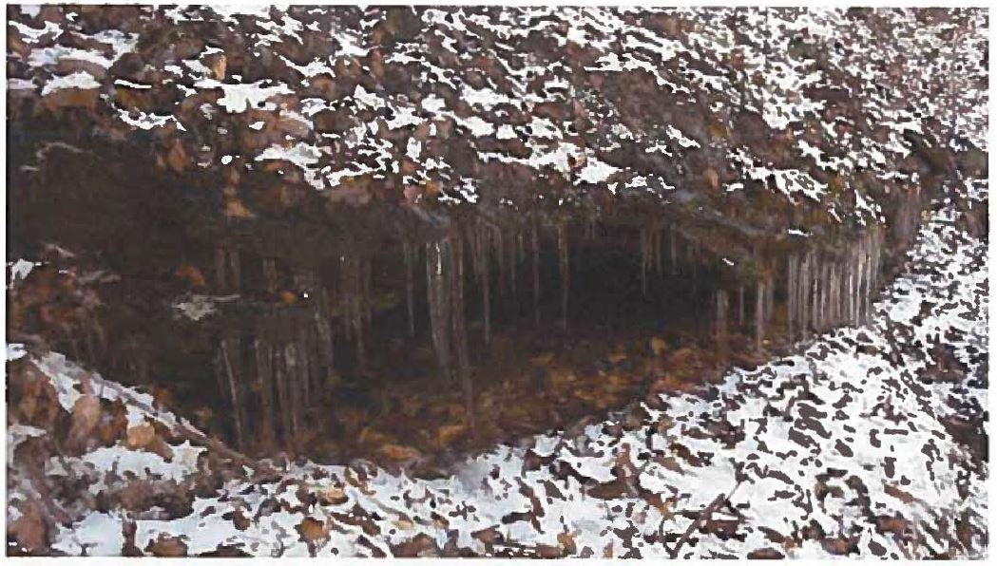
EXISTING CONDITIONS
10-162.00
- Westbound Lanes.
- Cemetery
- Rock Shelter on USFS property.

Slide 5
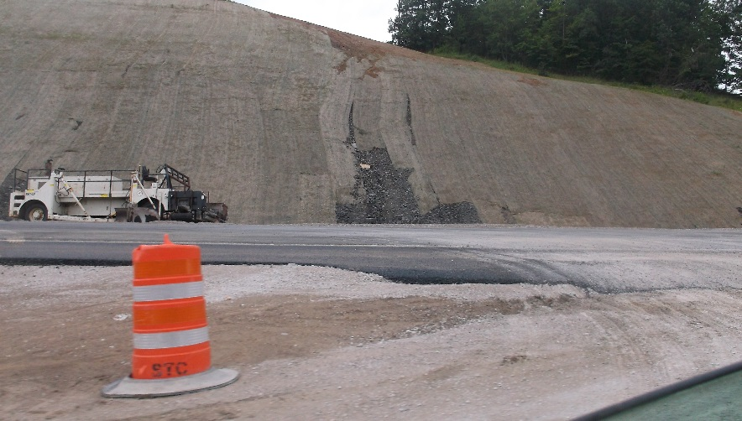
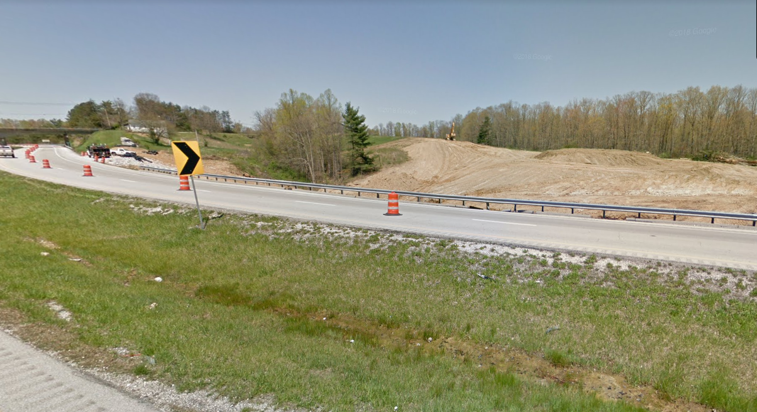
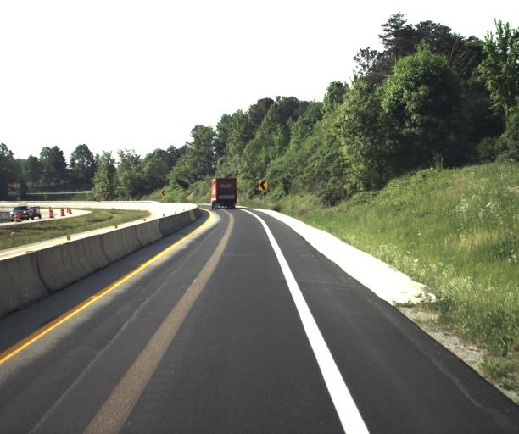
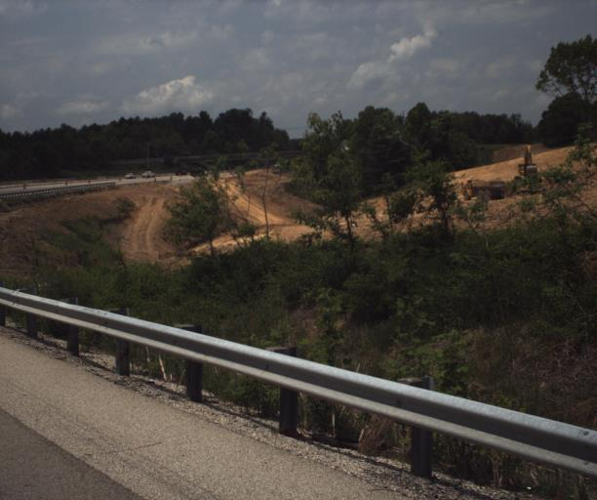
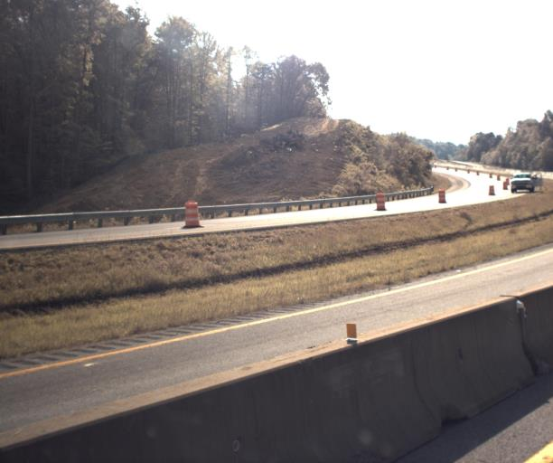
CONSTRUCTION
10-162.00

Slide 6
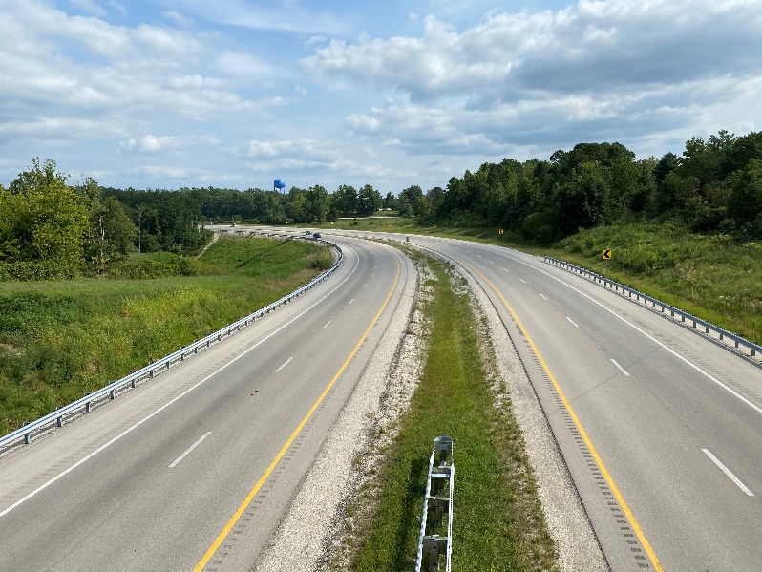
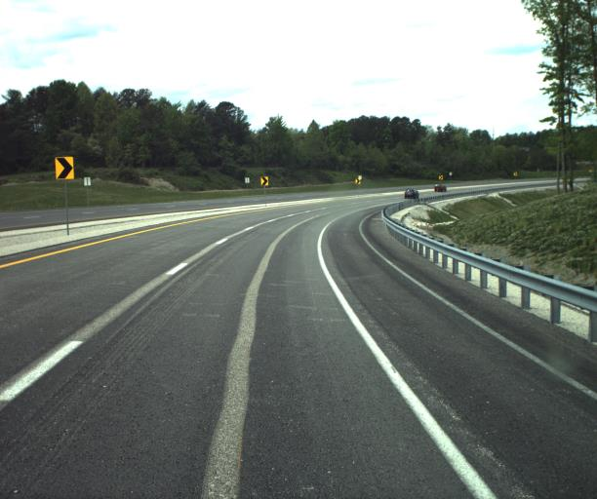
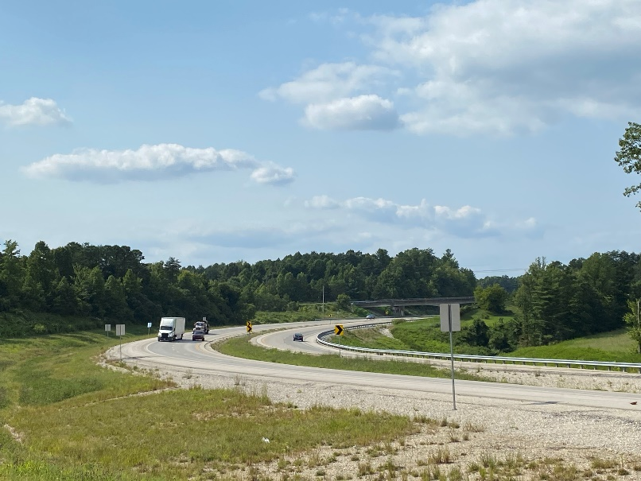
10-162.00

